Slide 1
Water Quality Classification
Name of the guide:
Mrs G.Sunitha Rekha (Sr. Asst. Professor)
Team members:
1) AKASH MYAKALA (20B81A1264)
2) YADURU LAHARI PRIYA (20B81A1279)
3) SISTLA SATHYA MURARI (20B81A12A3)

Slide 2
Abstract of the Project
Water is a resource that is essential for sustaining life and must be of high enough quality. The approved uses for surface and ground waters are determined by water quality classifications, which are based on water quality criteria. Several variables, including pH, turbidity, electrical conductivity, dissolved oxygen, nitrate, temperature, and biochemical oxygen demand, can be used to identify water contamination. The categorization of water quality using machine learning techniques might involve data collection, preprocessing, feature selection, model training, assessment, and deployment. To categorise the water quality of different kinds of water bodies, decision trees, random forests, support vector machines, and artificial neural networks have been used. By detecting water contamination early and managing it effectively, this strategy has the potential to revolutionise the management of water resources.

Slide 3
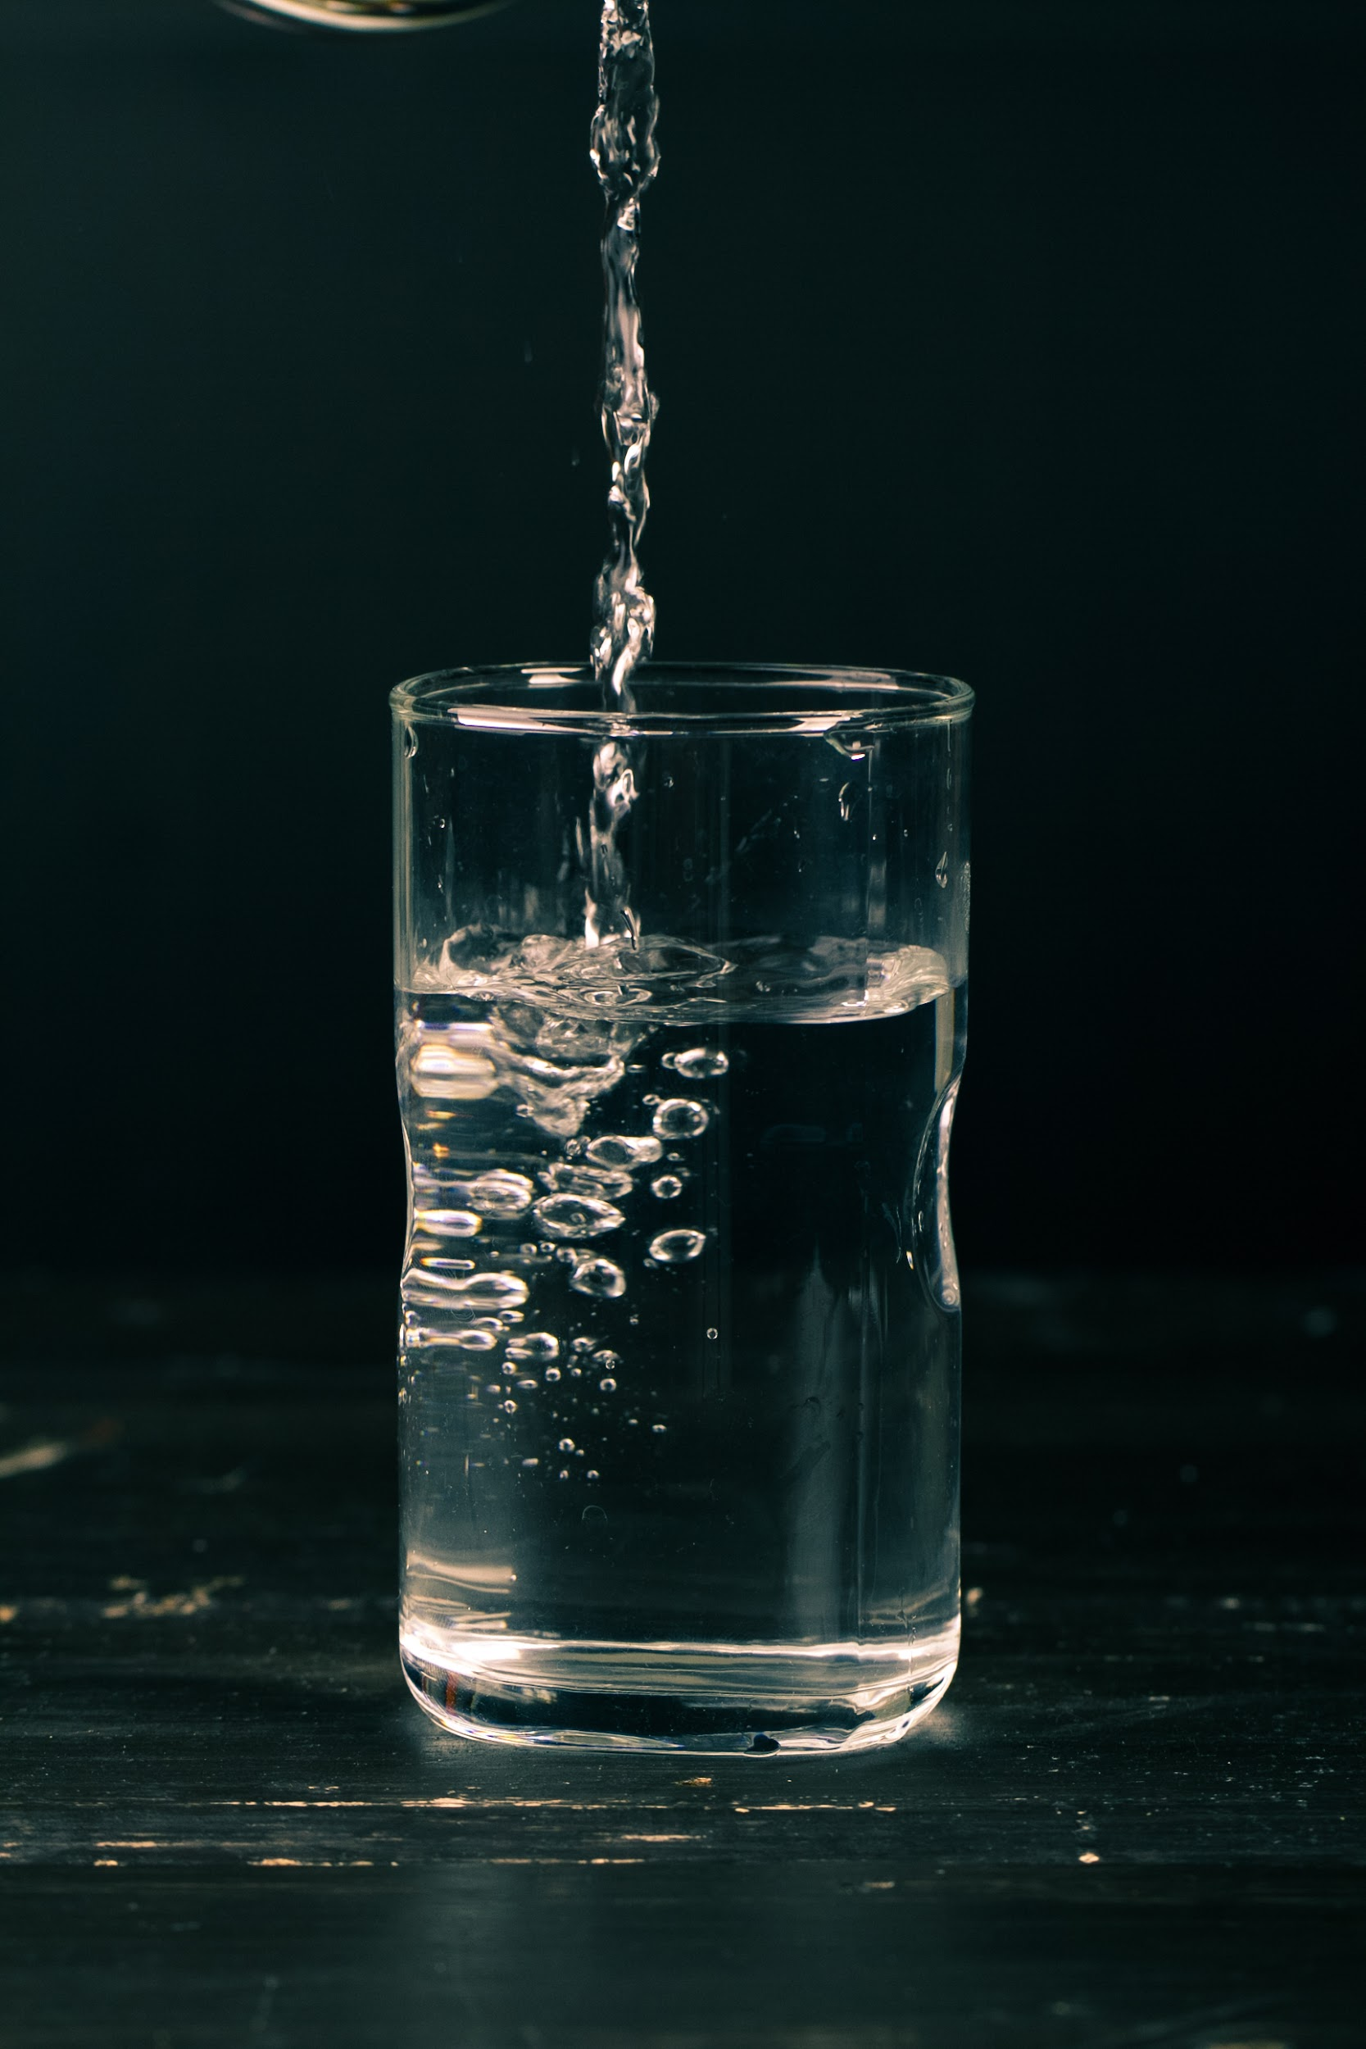
Introduction
Water is essential for life, so its quality is incredibly important for people and the environment. But, water quality can be affected by things like pollution, weather, and land use. This is why monitoring water quality is so important. Our project aims to create a system to classify water samples based on their quality. It'll use machine learning algorithms to identify patterns between different water quality features and give accurate results. This project could help make water monitoring more efficient, ultimately protecting human health and the environment.

Slide 4
Review and Limitations of the Existing Works
Various studies have been conducted on water quality classification using different methods and techniques. Some studies have used traditional statistical methods, such as principal component analysis (PCA), while others have used machine learning algorithms, such as artificial neural networks (ANNs) and support vector machines (SVMs).
PCA have been widely used for water quality classification due to their simplicity and ease of use. However, they have some limitations, such as the assumption of normality and linearity of the data, which may not hold for all types of water quality data. Moreover, they may not perform well when dealing with high-dimensional and complex datasets.
Machine learning algorithms, on the other hand, have shown promising results in water quality classification due to their ability to handle high-dimensional and complex data. ANNs and SVMs have been particularly successful in this regard, as they can learn complex nonlinear relationships between different water quality parameters and accurately classify water samples into different categories.
Despite these advancements, there are still some limitations and gaps in the current knowledge of water quality classification. For instance, most studies have focused on a limited number of water quality parameters, such as pH, temperature, and dissolved oxygen, and may not account for other important parameters, such as nutrients, metals, and organic matter. Moreover, the performance of different classification methods may vary depending on the type of water body and the specific water quality parameters under consideration. Therefore, further research is needed to develop more accurate and reliable methods for water quality classification that can handle a wide range of water quality parameters and environmental conditions.

Slide 5
Software Requirement Specification with functional and non-functional requirements
Functional Requirements:
Collect water quality data from sensors, manual measurements, and external databases.
Preprocess data through cleaning, filtering, and normalization.
Train and test classification models (PCA, NNs, SVMs) on preprocessed data.
Evaluate model performance based on accuracy, precision, recall, and F1 score.
Visualize results using graphs, charts, and tables.
Non-Functional Requirements:
User-friendly interface with clear instructions.
Reliable and robust with minimal errors, bugs, and crashes.
Efficient with reasonable response times and processing speeds.
Secure and protect sensitive data from unauthorized access and manipulation.
Compatible with Windows, macOS, and Linux operating systems.

Slide 6
Problem Statement and Description
The purpose of this project is to find a way to accurately and quickly classify water quality based on various factors. This is critical for our health and the environment. But traditional methods are limited when it comes to handling large datasets and complex relationships between water quality parameters. So, the solution is to create software that uses advanced machine learning algorithms to classify samples based on multiple parameters. This will provide a more comprehensive and reliable approach to water quality classification, allowing us to identify and address potential water quality issues promptly.

Slide 7
Motivation and Scope of the Project
The motivation behind this project is to improve the accuracy and efficiency of water quality classification, which is essential for ensuring the safety of water sources for human consumption and maintaining ecological balance. The current methods of water quality classification have limitations in handling large datasets and complex relationships between different water quality parameters, which can result in inaccurate and unreliable classification results. Therefore, there is a need for a more comprehensive and reliable approach to water quality classification.
The scope of this project is to develop a software tool that can collect, preprocess, and analyze water quality data using advanced machine learning algorithms. The tool will enable accurate classification of water samples based on multiple parameters and provide a more comprehensive understanding of the water quality situation. The benefits of this project include identifying potential water quality issues in a timely manner, enabling efficient allocation of resources for water management, and improving the overall quality of water sources. The proposed tool can be used by water management authorities, researchers, and other stakeholders involved in the monitoring and management of water resources.

Slide 8
Brief Description of the Modules in the Project
Data Preprocessing: This module is responsible for preprocessing the collected data, including data cleaning, filtering, and normalization, to prepare it for analysis.
Feature Selection: This module is responsible for selecting the most relevant features (water quality parameters) that contribute the most to the classification performance.
Model Selection and Training: PCA(Principal Component Analysis)
Model Evaluation: This module is responsible for evaluating the performance of different classification models based on various metrics, such as accuracy, precision.
Model Selection and Training:NNs(Neural Networks)
User Interface: This module provides a graphical user interface (GUI) for the software tool, allowing users to easily interact with the different modules and view the results. The GUI will also provide clear instructions and feedback to the users.
Model Selection and Training: SVMs(Support vector machine).

Slide 9
Minimum Configuration of Hardware and Software Requirements
Minimum Hardware Requirements:
Processor: Intel Core i5 or equivalent
RAM: 8 GB or higher
Hard disk space: 100 GB or higher
Graphics card: NVIDIA or AMD with at least 2 GB of memory
Minimum Software Requirements:
Operating system: Windows 10 or later, macOS 10.12 or later, or a recent version of Linux
Python 3.6 or later with the following libraries: NumPy, Pandas, Scikit-learn, TensorFlow, Keras, Matplotlib, and Seaborn
Jupyter Notebook or similar development environment
Database management system, such as MySQL or PostgreSQL

Slide 10
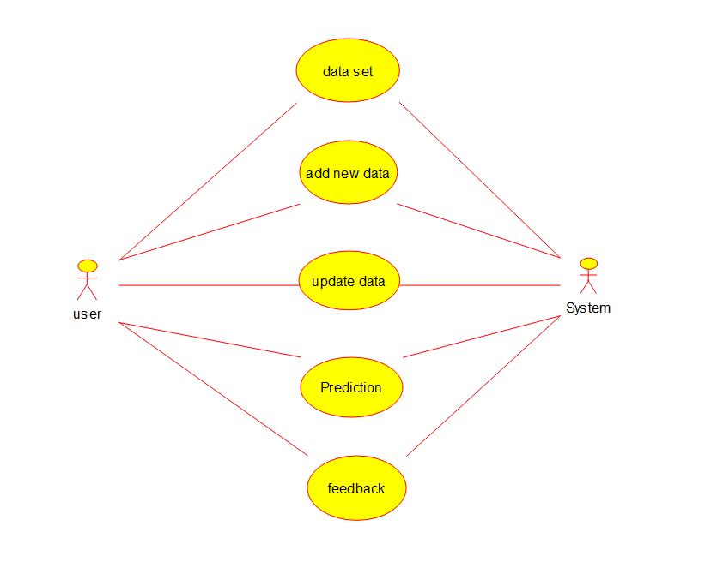
Use Case Diagram
Use case diagrams are used to represent the interactions between users and a system. They help to identify the different actors involved and the various use cases that the system can perform.

Slide 11
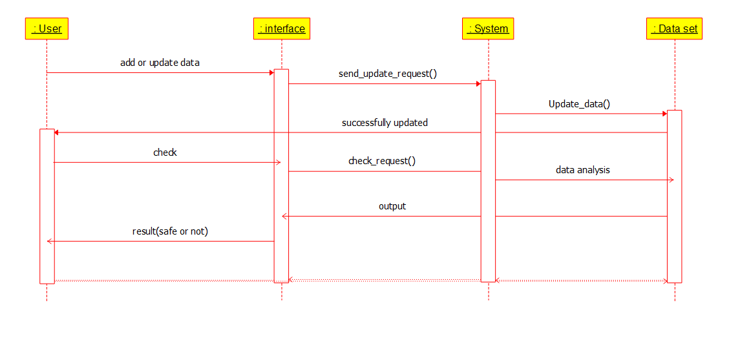
Sequence Diagram
Sequence diagrams are used to represent the interactions between objects in a system. They help to identify the different objects involved and the sequence of events that occur during a particular use case.

Slide 12
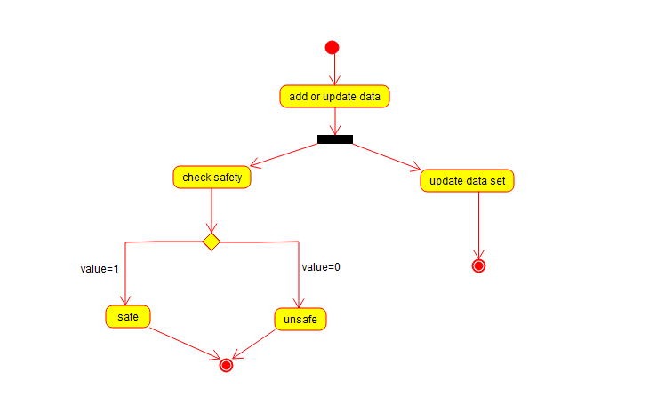
Activity Diagram
Activity diagrams are used to represent the flow of activities in a system. They help to identify the different activities involved and the sequence in which they occur.

Slide 13
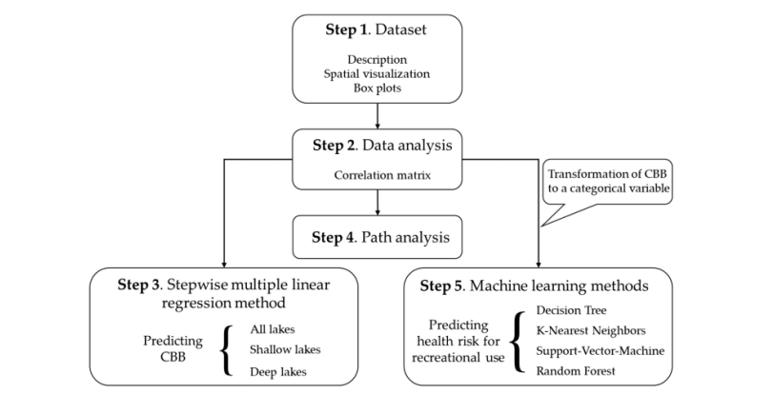
Architectural Diagram or User Interface Diagram

Slide 14
Conclusions and Major Contribution
The objective of the Water quality classification project is to develop a machine learning model that can accurately classify water samples based on various parameters, such as pH, temperature, dissolved oxygen, turbidity, and specific contaminants. The methodology involves collecting relevant water quality data from various sources, cleaning and preprocessing the data to ensure its accuracy and usability, selecting appropriate features and algorithms for modeling, and evaluating the model's performance using various metrics. Feature importance and contribution analysis are also performed to gain insights into the underlying factors and mechanisms that affect water quality. Ultimately, the project aims to provide a useful tool for water quality monitoring and management that can help ensure safe and sustainable water resources for communities and ecosystems.

Slide 15

References
H. Zhang, J. Liu, J. Zhang, L. Li, "Water Quality Classification Using Principal Component Analysis and Artificial Neural Networks," Water Resources Management, vol. 31, no. 4, pp. 1291-1305, 2017.
Y. Li, X. Li, G. Li, "Water Quality Classification Using Support Vector Machines and Multivariate Statistical Analysis," Water Science and Technology, vol. 76, no. 7, pp. 1884-1894, 2017.
R. Tahir, M. U. Ilyas, S. U. Khan, M. S. Aslam, "Water Quality Classification Using Data Mining Techniques: A Review," Environmental Science and Pollution Research, vol. 25, no. 6, pp. 5178-5195, 2018.
W. Song, X. Luo, X. Shen, J. Liu, "Water Quality Classification Based on Fuzzy Logic and Artificial Neural Networks," International Journal of Environmental Research and Public Health, vol. 16, no. 3, p. 434, 2019.
"Water Quality," United States Environmental Protection Agency, [Online]. Available: https://www.epa.gov/wqs-info/water-quality-standards-regulations. [Accessed: May 3, 2023].
"Water Quality," World Health Organization, [Online]. Available: https://www.who.int/water_sanitation_health/water-quality/en/. [Accessed: May 3, 2023].

Slide 16
Thank you

